Slide 1
Title Slide
2022
Presented by

Slide 2
Title Slide
2022
Presented by

Slide 3
Section Title Card

Slide 4
Section Title Card

Slide 5


Copy & pasting old slides into this template
Copy and paste single or multiple slides from your source deck into this destination template
With pasted slides still selected, locate clipboard icon for
Paste Options and choose “Use Destination Theme”
  On a Windows it will be located in the lower right
  On a Mac it is located on the last inserted slide
Windows:
“Use Destination Theme” is the left option
Mac:
Click the clipboard icon to reveal drop-down menu, select “Use Destination Theme”

Slide 6
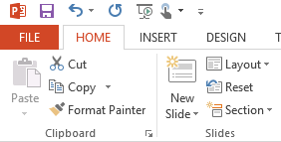
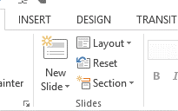
Applying the theme & slide layouts to your new file
Menu Bar of Your New File
In Normal View:
  Select appropriate layout
  option from Layout menu
  Windows, click the
  “Reset” button
You will need to determine the proper layout for each slide individually
Graphic elements may need to be adjusted to reflect the new color palette
Some slide elements may need layout adjustments on an individual basis
If pasting 3:4 ratio slides into this 16:9 template, you’ll need to cut and paste the graphical elements onto the slide surfaces to avoid stretching the images

Slide 7
Title, Lato Black 36pt dark blue
Bullet 1, Lato 20pt gray, sentence case
  Bullet 2, Lato 18pt gray, sentence case
    Bullet 3, Lato 16pt gray, sentence case
      Bullet 4, Lato 14pt gray, sentence case

Slide 8

Title, Lato Black 36pt dark blue
www.lendingtree.com/creative
Icon bullet, Lato 20pt gray, sentence case
Icon bullet, Lato 20pt gray, sentence case
Icon bullet, Lato 20pt gray, sentence case
Icon bullet, Lato 20pt gray, sentence case
Icon bullet, Lato 20pt gray, sentence case

Slide 9
Title, Lato Black 36pt dark blue
Bullet 1, Lato 20pt gray, sentence case
  Bullet 2, Lato 18pt gray, sentence case
    Bullet 3, Lato 16pt gray, sentence case
      Bullet 4, Lato 14pt gray, sentence case

Slide 10
Title with subhead, Lato Black 33pt dark blue
www.lendingtree.com/creative
Bullet 1, Lato 20pt gray, sentence case
  Bullet 2, Lato 18pt gray, sentence case
    Bullet 3, Lato 16pt gray, sentence case
      Bullet 4, Lato 14pt gray, sentence case

Slide 11
Title with subhead, Lato Black 33pt dark blue
www.lendingtree.com/creative

Slide 12
Two column bullet content with subhead
www.lendingtree.com/creative
Bullet 1, Lato 20pt gray, sentence case
  Bullet 2, Lato 18pt gray, sentence case
    Bullet 3, Lato 16pt gray, sentence case
      Bullet 4, Lato 14pt gray, sentence case
Bullet 1, Lato 20pt gray, sentence case
  Bullet 2, Lato 18pt gray, sentence case
    Bullet 3, Lato 16pt gray, sentence case
      Bullet 4, Lato 14pt gray, sentence case

Slide 13
Two column bullet content
Bullet 1, Lato 20pt gray, sentence case
  Bullet 2, Lato 18pt gray, sentence case
    Bullet 3, Lato 16pt gray, sentence case
      Bullet 4, Lato 14pt gray, sentence case
Bullet 1, Lato 20pt gray, sentence case
  Bullet 2, Lato 18pt gray, sentence case
    Bullet 3, Lato 16pt gray, sentence case
      Bullet 4, Lato 14pt gray, sentence case

Slide 14
Icon headline
Icon bullet, Lato 20pt gray, sentence case
Icon bullet, Lato 20pt gray, sentence case
Icon bullet, Lato 20pt gray, sentence case
Icon bullet, Lato 20pt gray, sentence case
14

Slide 15
ACT WITH URGENCY
AND CREATIVITY
TAKE CHARGE
COMMIT TO EXCELLENCE
SET BIG GOALS &
BE ACCOUNTABLE
Search for ideas everywhere, inside and outside the company. Test, debate, and develop ideas until you quickly find the best answer. Then, execute with urgency and a sense of purpose.
Take charge. Ask for the ball. Make a decision and stand by it. Or at least step up and propose a clear course of action, and if you can’t get an answer quickly, move out.
Have big ambitions. Live up to your full potential. Keep learning, and don’t be afraid to take on more responsibility and tackle larger challenges. And, to live up to your full potential as a leader, it’s critical that you empower, encourage, help, and teach others so they can reach their full potential too.
Set big goals AND hold yourself, your co-workers, and your company accountable for results, no matter what obstacle is in your way. Results matter. A lot.

Slide 16
ACT WITH URGENCY AND CREATIVITY
COMMIT TO
EXCELLENCE
Important headline callout here
Search for ideas everywhere, inside and outside the company. Test, debate, and develop ideas until you quickly find the best answer. Then, execute with urgency and a sense of purpose.
Have big ambitions. Live up to your full potential. Keep learning, and don’t be afraid to take on more responsibility and tackle larger challenges. And, to live up to your full potential as a leader, it’s critical that you empower, encourage, help, and teach others so they can reach their full potential too.
TAKE
CHARGE
SET BIG GOALS &
BE ACCOUNTABLE
Take charge. Ask for the ball. Make a decision and stand by it. Or at least step up and propose a clear course of action, and if you can’t get an answer quickly, move out.
Set big goals AND hold yourself, your co-workers, and your company accountable for results, no matter what obstacle is in your way. Results matter. A lot.

Slide 17
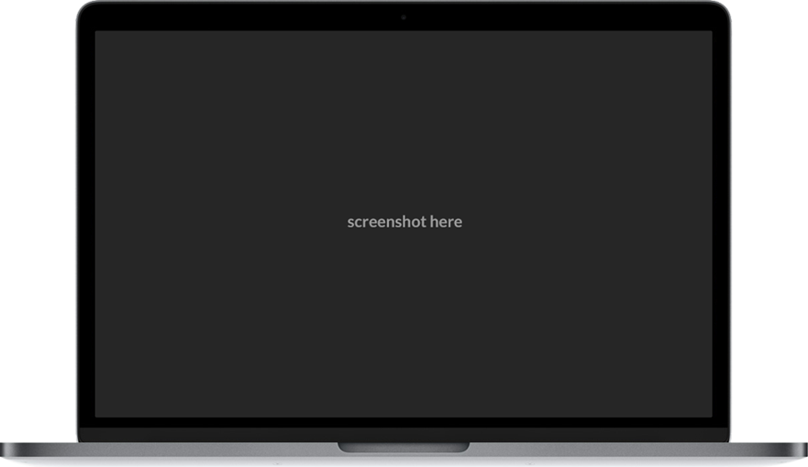

Screenshot treatment
Subhead Lato 19pt green
To add a screenshot image to the laptop:
PC: From the Insert tab at the top of the screen, select Pictures > Picture from file…
Mac: From the Home tab at the top of the screen, select Picture > Picture from file...
Then choose the image you want to use from your computer. Click the Insert button.
Slide your imported image over the laptop and scale until it fits into the dark gray screen area. If it doesn’t fit exactly, fill the image until all of the dark gray screen is covered, then crop vertically or horizontally as needed. Crop by right clicking on your image > Crop. Then adjust the black rectangle toggle on either side of your image (not the corners) as needed to perfectly fill the screen.
Delete this instruction box and add your content
Call out here

Slide 18

Add screen shot to black phone
Subhead Lato 19pt green
To add a screenshot image to the phone:
PC: From the Insert tab at the top of the screen, select Pictures > Picture from file…
Mac: From the Home Tab at the top of the screen, select Picture > Picture from file...
Then choose the image you want to use from your computer. Click the Insert button.
Then, slide your image over the phone and size it until it fits the entire phone screen.
If any of your image extends beyond the phone perimeter, further crop by right clicking on your image > Crop. Then adjust the black rectangle toggle on either side of your image (not the corners) as needed to perfectly fill the screen. Click off the image to turn off the cropping feature.
PC: Select your image again. Under the Format tab at the top of the screen, click the dropdown arrow on the right side of the mountain icons. Hover over the small mountain icons. If you pause over each one, the name of that effect will appear. Select Bevel Rectangle.
Mac: Select your image again. Under the Picture Format tab at the top of the screen, hover over the small mountain icons and click the small downward pointing arrow in the center of the mountain choices. Select Bevel Rectangle which is the far right button on the third row.
Then, look for the small, yellow square on the top-left of your imported image. Slide this square left and right to adjust the corner radius to match the phone frame.
Finally, select your image > Right Click > Send to Back > Send to Back.
Delete this instruction box and add your content
Headline
Supporting text can go here to clarify anything you want the viewers to focus on.

Slide 19

Add screen shot to black phone
Subhead Lato 19pt green
To add a screenshot image to the phone:
PC: From the Insert tab at the top of the screen, select Pictures > Picture from file…
Mac: From the Home Tab at the top of the screen, select Picture > Picture from file...
Then choose the image you want to use from your computer. Click the Insert button.
Then, slide your image over the phone and size it until it fits the entire phone screen.
If any of your image extends beyond the phone perimeter, further crop by right clicking on your image > Crop. Then adjust the black rectangle toggle on either side of your image (not the corners) as needed to perfectly fill the screen. Click off the image to turn off the cropping feature.
PC: Select your image again. Under the Format tab at the top of the screen, click the dropdown arrow on the right side of the mountain icons. Hover over the small mountain icons. If you pause over each one, the name of that effect will appear. Select Bevel Rectangle.
Mac: Select your image again. Under the Picture Format tab at the top of the screen, hover over the small mountain icons and click the small downward pointing arrow in the center of the mountain choices. Select Bevel Rectangle which is the far right button on the third row.
Then, look for the small, yellow square on the top-left of your imported image. Slide this square left and right to adjust the corner radius to match the phone frame.
Finally, select your image > Right Click > Send to Back > Send to Back.
Delete this instruction box and add your content
Headline
Supporting text can go here to clarify anything you want the viewers to focus on.

Slide 20





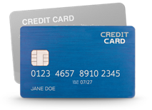



Mortgage
Auto Loans
Student Loans
Personal Loans
Credit Cards
Deposit Accounts
Business Loans
Insurance

Slide 21
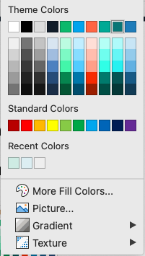
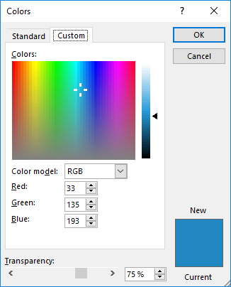
Illustrated icons
We’ve included an icon library on the following pages. Use any icons throughout
your presentation. Also, feel free to recolor to best suit your page.
Please limit your color usage to the top line Theme Colors for cohesiveness.
  To recolor, click once on the desired icon and select Shape Fill from the tool ribbon above to select a new color.

Slide 22




Photography
  Paste an image into PPT
  Double click on the image to get to Picture Format.
  Click Crop and crop the image to a perfect square.
  Then click on Crop > Crop to Shape > Oval in order to stylize your photos.
  Accessible background oval shape image colors
Light Blue
R: 224
G: 248
B: 244
Light Green
R: 212
G: 238
B: 231

Slide 23
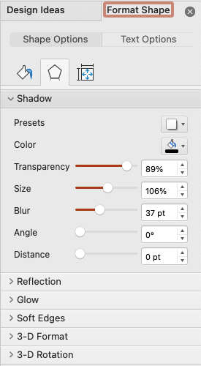
Content blocks
Use this shape to create emphasis on content or to break up areas of text.
  To create the shape go to Shapes > Rounded Rectangle
  Fill Color: White, Background 1
  Format Shape > Shape Options > Shadow
    Color: Black, Text 1
    Transparency: 89%
    Size: 106%
    Blur: 37pt
    Angle: 0%
    Distance: 0pt
To Emphasize Content
Use this block
And add supporting copy if you need to.
  Add text by double clicking on the shape. Format the text by using the alignment features found under Shape Format.
  For unique text styling, create your text in separate Textboxes and Arrange them to the front of the shape.
View next page for more examples.

Slide 24
Content blocks
Use this shape to create emphasis on content or to break up areas of text.
HEADLINE
To Emphasize Content
Add supporting copy here or images such as logos.
Icon bullet, Lato 20pt gray
Icon bullet, Lato 20pt gray
Icon bullet, Lato 20pt gray
Icon bullet, Lato 20pt gray

Slide 25
Icons – LendingTree Products

Slide 26
Icons – Credit Cards
Icons – System

Slide 27
Icons – Universal

Slide 28
Icons – Universal

Slide 29



Images

Slide 30



Images

Slide 31



Images

Slide 32
Color palette
www.lendingtree.com/creative
Primary colors
Secondary colors
LendingTree Green
R: 8
G: 193
B: 119
Hopper Green (Icons)
R: 0
G: 178
B: 159
OG Link Blue
R: 0
G: 174
B: 239
White
R: 255
G: 255
B: 255
Deep Azul
R: 16
G: 31
B: 48
Deep Verde
R: 7
G: 129
B: 129
Yellow
R: 255
G: 197
B: 7
Dark Gray
R: 51
G: 51
B: 51
Electric Salmon
R: 255
G: 112
B: 76
Ocean Blue
R: 33
G: 135
B: 193
Purple
R: 105
G: 49
B: 158
Medium Gray
R: 163
G: 163
B: 163
Light Gray
R: 225
G: 225
B: 225

Slide 33
Bar with line chart style

Slide 34
Column chart style

Slide 35
Column chart style

Slide 36
Stacked column chart style

Slide 37
Line chart style

Slide 38
Bar chart style

Slide 39
Pie chart style

